Slide 1
Project Report
Software engineering - Group 8

Slide 2
Group member
Hoàng Thị Nhung
Nguyễn Xuân Nam
Phùng Nguyên Ngọc

Slide 3
contents
A BRIEF LOOK
Ideas
Product introduction
Frameworks and structure
A DEEPER LOOK
Implementation
Git
Pivotal Tracker
Testing
Modeling
Process implementation

Slide 4
ideas
A webpage for learning English as purpose
Target: mainly for getting into software development for beginners
Simple, easy to apply some developing standards
Not go deeply on designing
Easily for further development
Efficiency on using assistant tools (Git, PivotalTracker)

Slide 5
Process implementation
discussion on Monday every week
Everybody talk about their work in the last week.
Solved unsolved together
plan work will do this week.

Slide 6
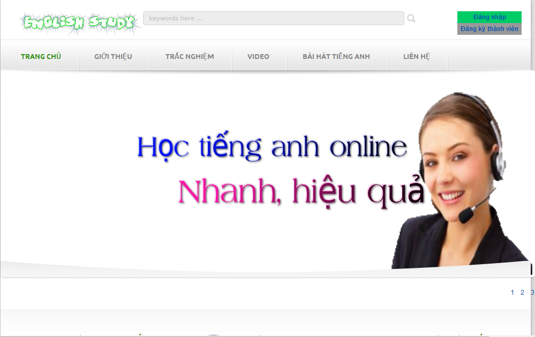
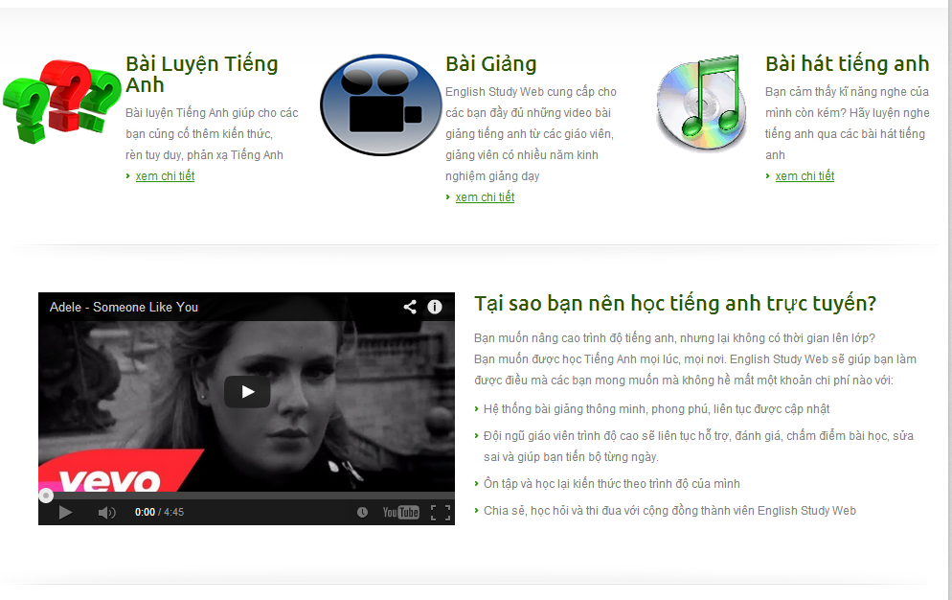
PRODUCT INTRODUCTION
HOME PAGE

Slide 7
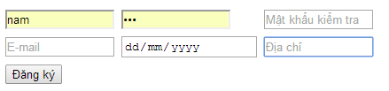
PRODUCT INTRODUCTION
SIGN UP

Slide 8
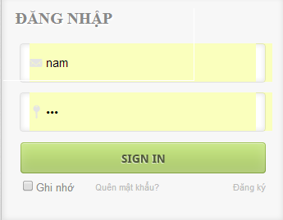
PRODUCT INTRODUCTION
SIGN IN

Slide 9
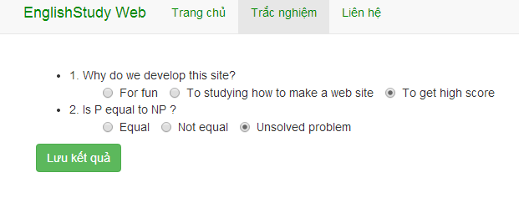
PRODUCT INTRODUCTION
MUTILPLE-CHOICE TEST
PS: Questions only for illustrative purposes

Slide 10
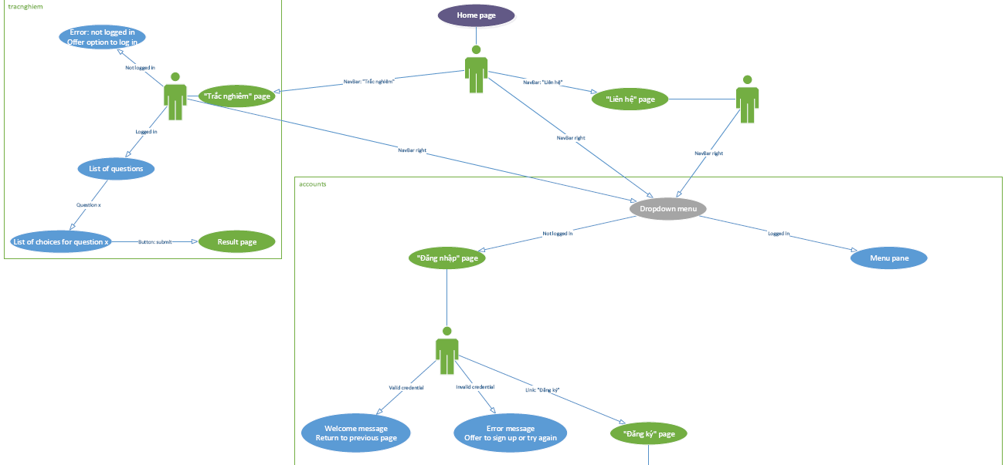
PRODUCT INTRODUCTION
Open logical use.png for more information

Slide 11
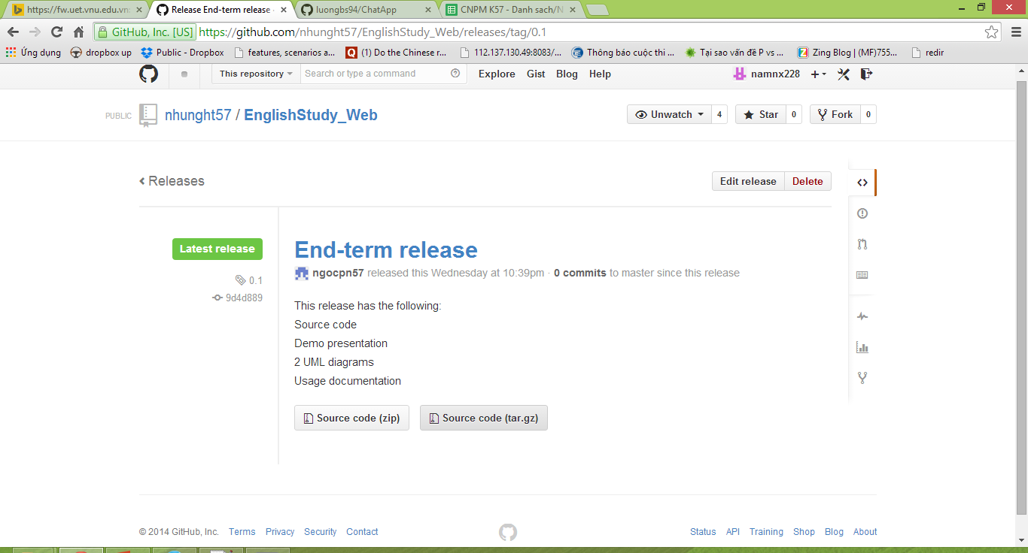
Release 0.1
Click here: https://github.com/nhunght57/EnglishStudy_Web/releases/tag/0.1

Slide 12
Frameworks and structure
This project is Django-based website
Django makes it easier to build better web apps more quickly and with less code
Multiple apps (details in Modeling section)
Structure : 3 layers
Model - for structuring and manipulating the data
View - encapsulate the logic responsible for processing a user’s request and for returning the response
Template - provides a designer-friendly syntax for rendering the information to be presented to the user

Slide 13
Progress management
Source control
We use Git with GitHub as the tools and server for storing and controlling source code
Progress control
We use Pivotal Tracker for managing user stories, then make implementation for them

Slide 14
implementation
Request user stories
Each story has short description as user’s view of a demanded new features, or any problem found by project contributors (bug, chore, ...)
Add labels, tasks for each story
Accepting stories, implement them and mark finished
Contributors who accepted the certain stories have the responsibility to implement, and when finished, they should return to Tracker and mark those stories as Finished
Commit to the Source controller (GitHub)

Slide 15
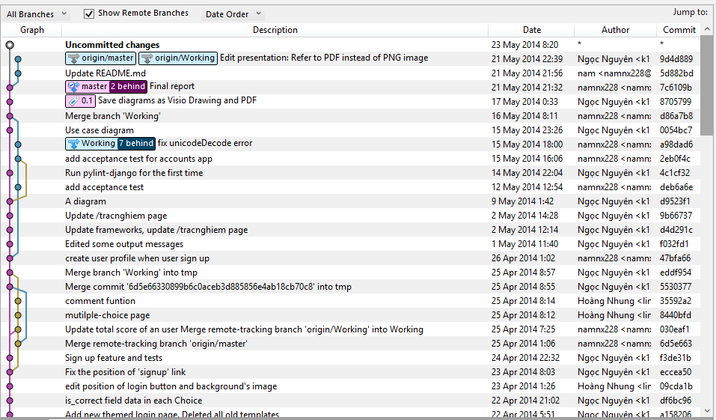
git

Slide 16
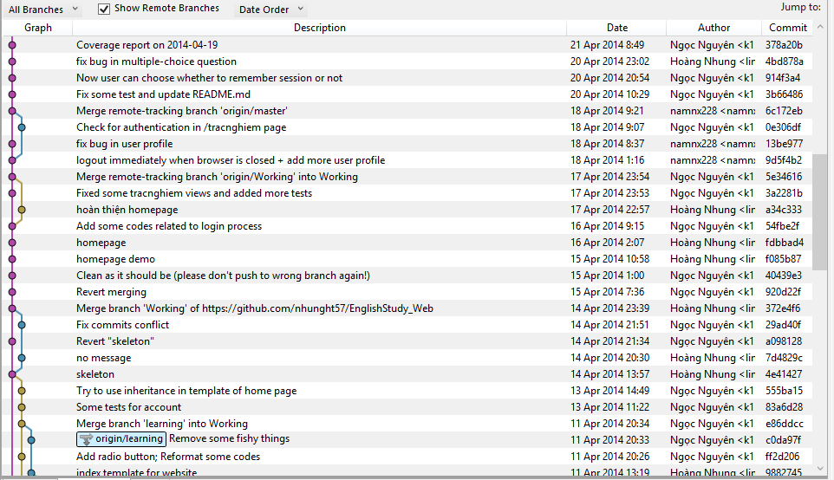
git

Slide 17
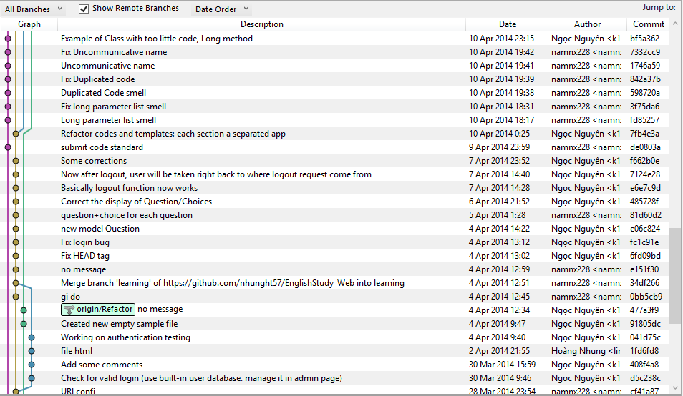
git

Slide 18
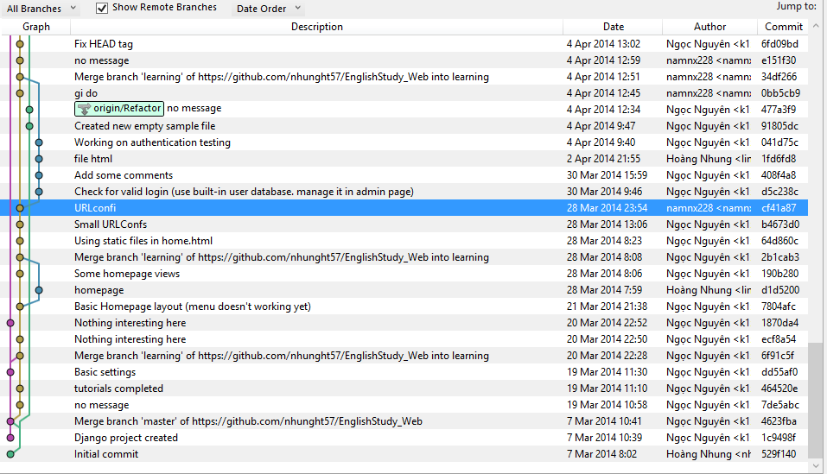
git

Slide 19
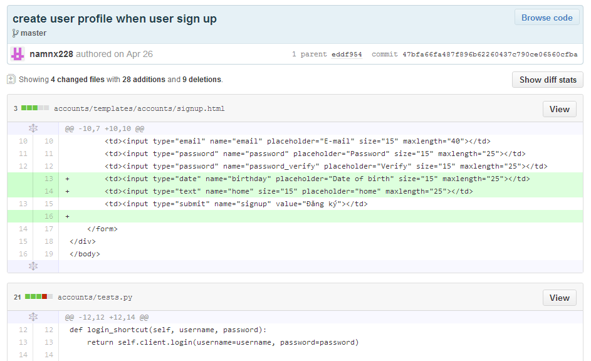

Slide 20
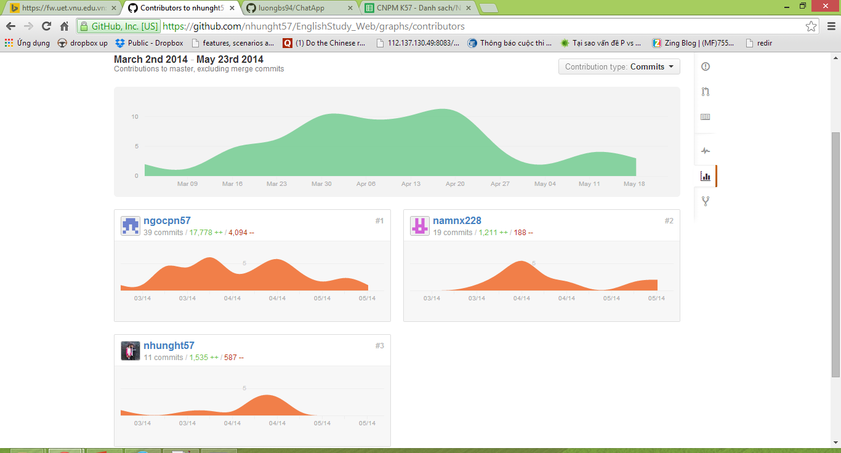
git

Slide 21
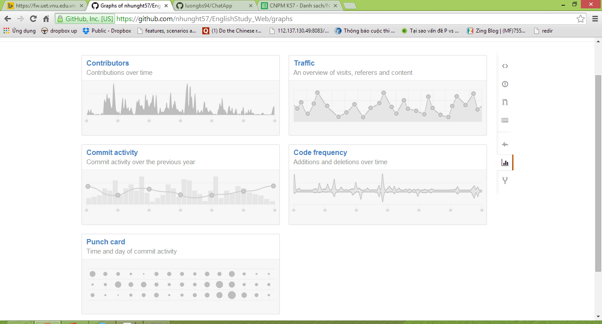
git

Slide 22
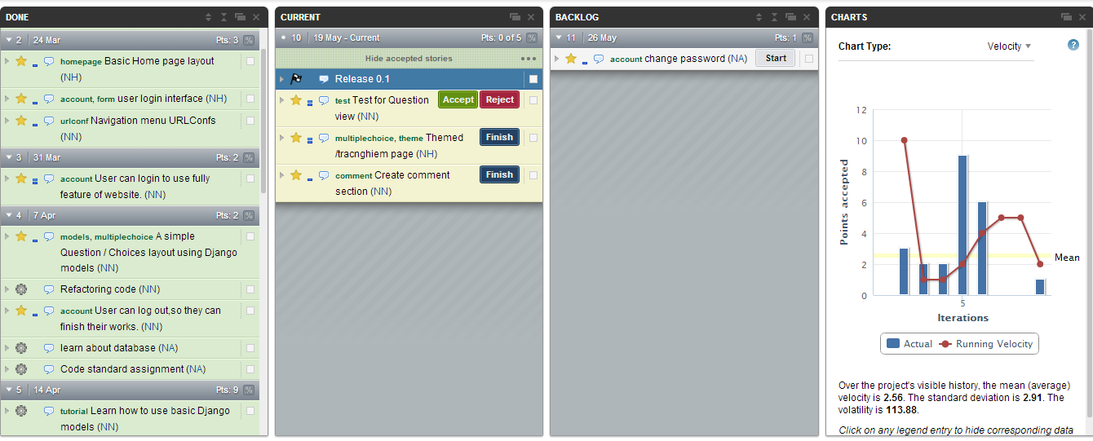
Pivotal tracker

Slide 23
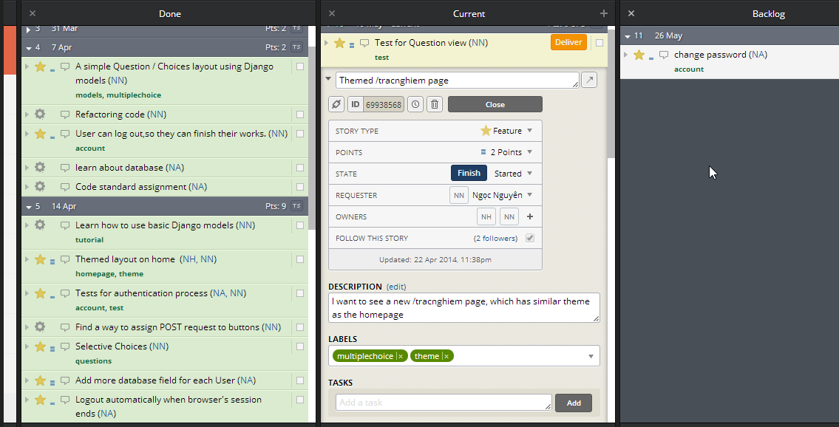
Pivotal tracker

Slide 24
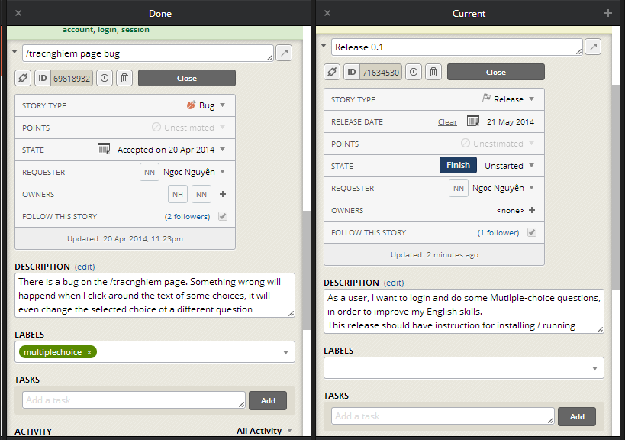
Pivotal tracker

Slide 25
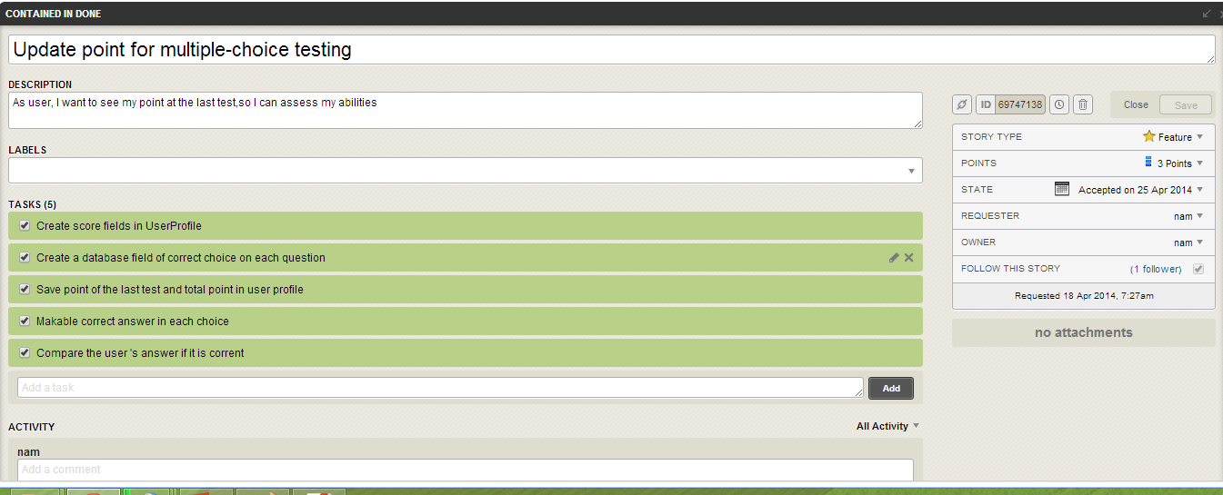
Pivotal tracker

Slide 26
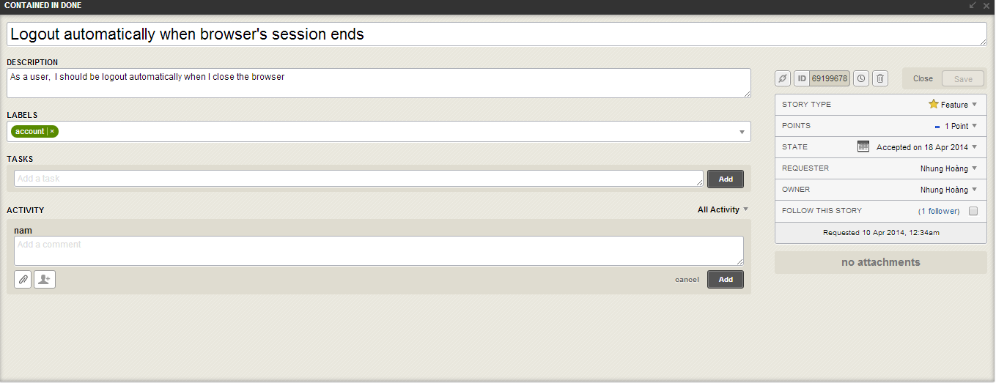

Slide 27
testing
Unit test
Acceptance test
Library for unit testing already implemented in Django
About 20 test cases
Test coverage: 75 – 90%
An old package called “lettuce” in Python (like “cucumber” in Rails)
Incompatible with Python 3, we have to use some deprecated codes for this package to works

Slide 28
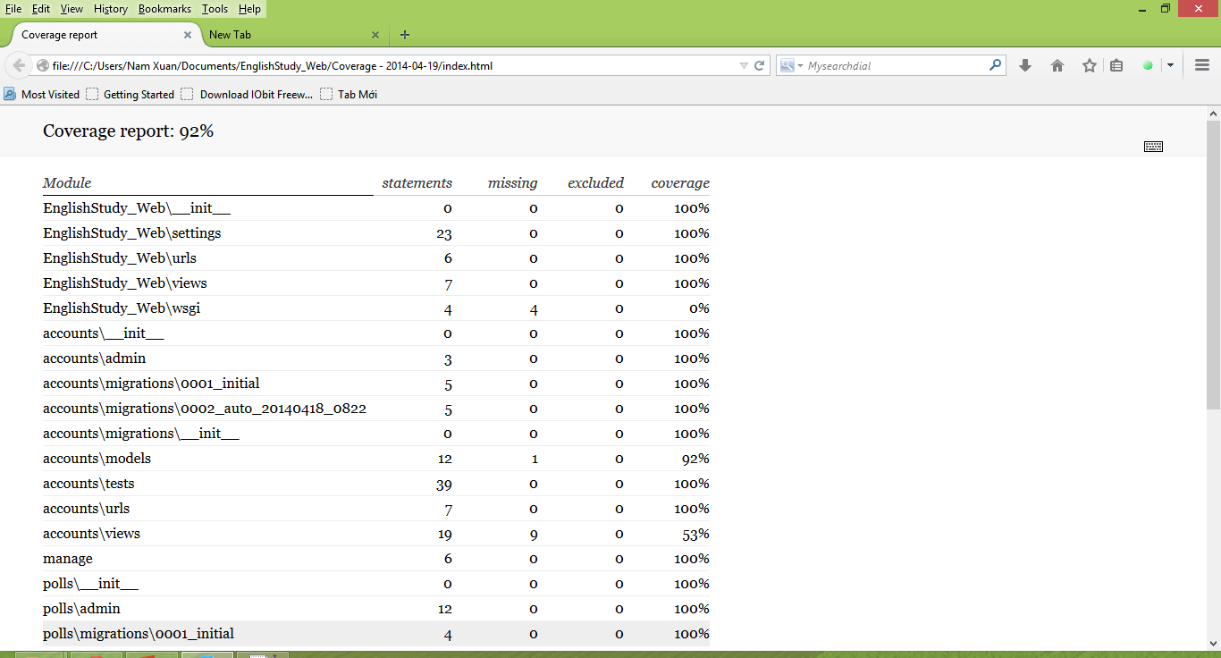
Unit test

Slide 29
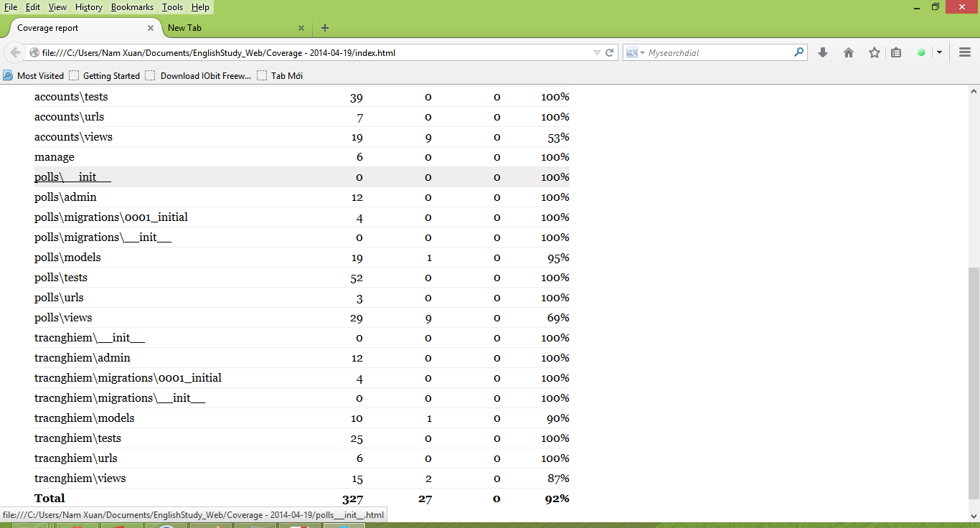
Unit test

Slide 30
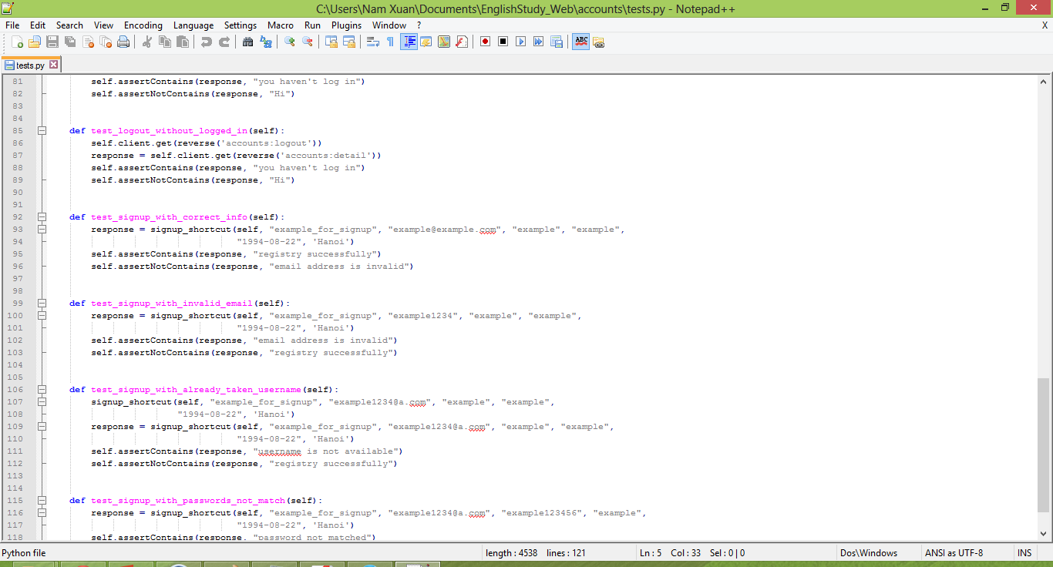
Unit test

Slide 31
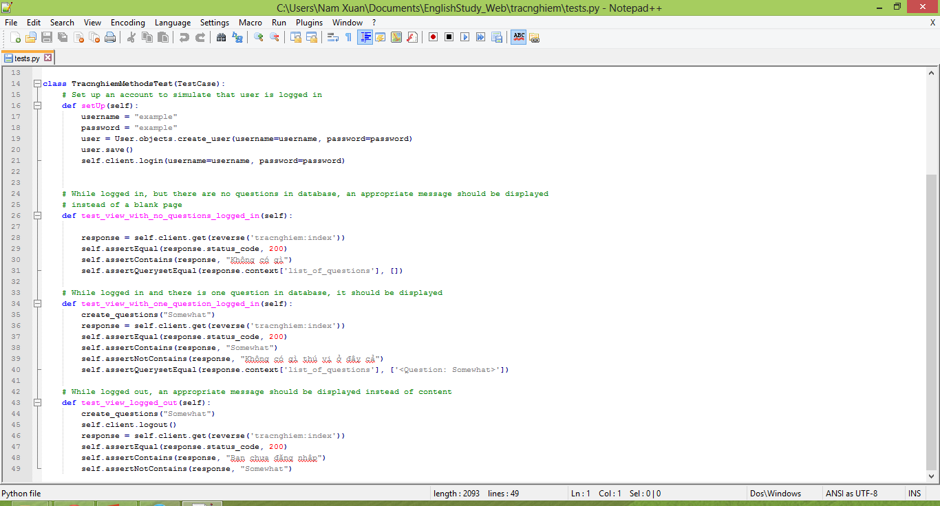
Unit test

Slide 32
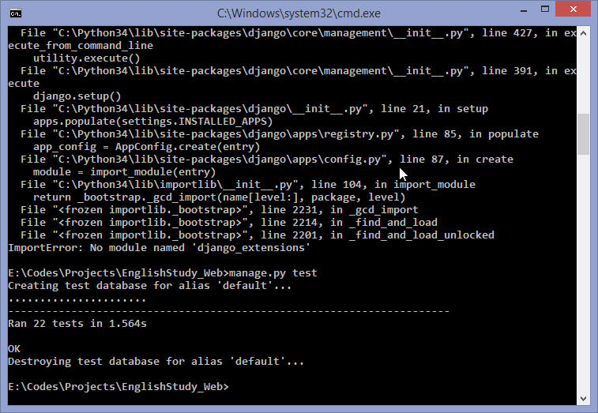
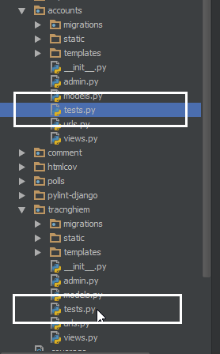
Unit test

Slide 33
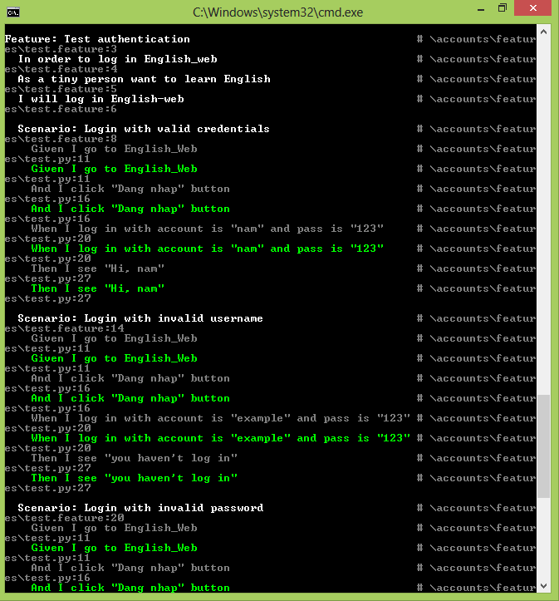
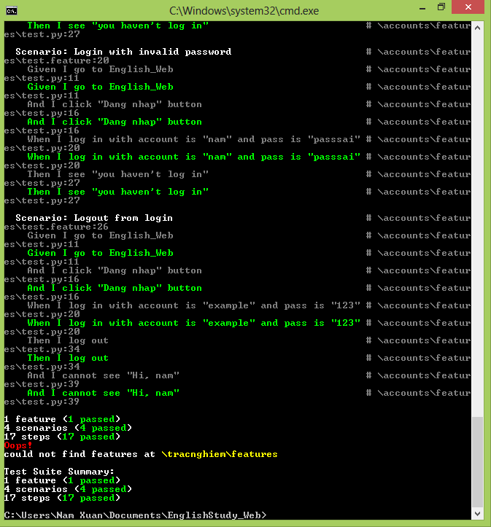
acceptance test

Slide 34
Testing

Slide 35
modeling
App: a web application that does something – e.g., a Weblog system
Our project apps: tracnghiem, accounts
Database: using Django’s model layer
Everything are explicitly declared in file models.py in each app

Slide 36
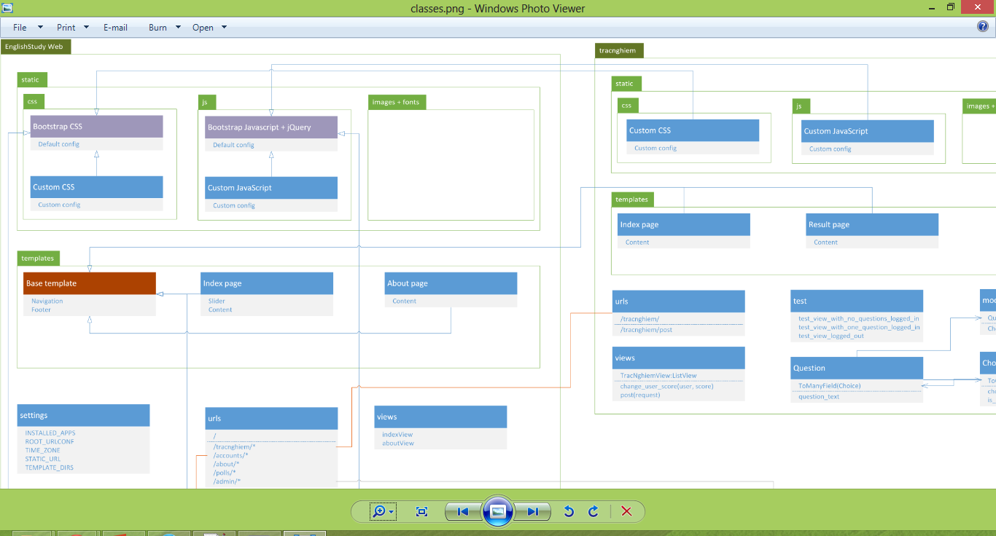
UML CLASS
For more information, open classes.png

